Slide 1
Combinational digital circuit

Slide 2
Lecture 30 Introduction to combinational circuit
Lecture delivered by:
Deepak V.

Slide 3
Objectives
At the end of this lecture, student will be able to:
Acquire the knowledge of combinational circuit
Describe AOI, NOR, NAND

Slide 4
Topics
Introduction to Combinational Circuit
Realization of logic expressions using AND-OR-Inverter gate combinations (AOI), NOR, NAND

Slide 5
Introduction to combinational circuit
What is a combinational circuit?
A combinational circuit consists of logic gates whose outputs at any
time are determined from only the present combination of inputs
In a combinational circuit combinational logic gates react to the
values of the signals at their inputs and produce the value of the
output signal
In contrast to sequential circuits combinational circuits do not
employ storage elements in addition to logic gates

Slide 6
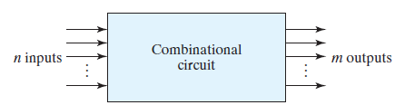
Introduction to combinational circuit
combinational circuit
Figure: Block diagram of combinational circuit

Slide 7
Introduction to combinational circuit
For n input variables, there are 2^{n} possible combinations
of the binary inputs
For each possible input combination, there is one possible
value for each output variable
A combinational circuit can be specified with a truth
table that lists the output values for each combination of
input variables

Slide 8
Introduction to combinational circuit
Truth table
A truth table for a combinational circuit consists of input
columns and output columns
The input columns are obtained from the 2^{n} binary numbers
for the n input variables
The binary values for the outputs are determined from the
stated specifications

Slide 9
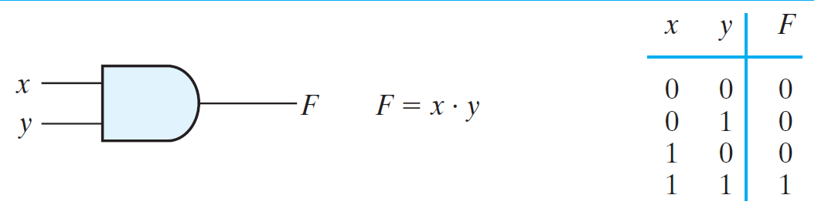
Introduction to combinational circuit
Truth table representation
Figure: Example of truth table

Slide 10
Realization of logic expressions using NAND
A convenient way to implement a Boolean function with
NAND gates is to implement the Boolean function using
basic gates (AND, OR and NOT)
The conversion of an algebraic expression from AND, OR,
and complement to NAND can be done by simple circuit
manipulation techniques
Also the implementation of Boolean functions with NAND
gates requires that the functions be in sum-of-products
form

Slide 11
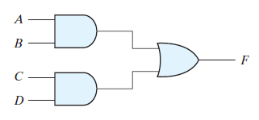
Realization of logic expressions using NAND
As an example consider the Boolean expression
F = AB + CD
The above expression can be realized using basic gates as shown
below:
Figure: Realization of Boolean expression

Slide 12
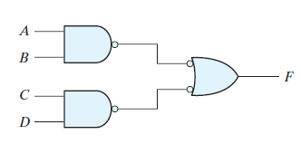
Realization of logic expressions using NAND
In the figure below it is observed that two bubbles are
added in each line
Two bubbles along the same line represent double
complementation hence the output is same as previous
circuit
Figure: Realization of Boolean expression

Slide 13
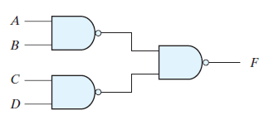
Realization of logic expressions using NAND
The bubbled OR gate in the second stage can be replaced by a NAND gate
Hence the circuit reduces as shown below
Figure: Realization of Boolean expression using NANDC
Thus a Boolean expression can be realized using NAND as discussed above.

Slide 14
Realization of logic expressions using NOR
Realization using NOR gates requires that the function be
simplified into product-of-sums form
A convenient way to implement a Boolean function with
NOR gates is to implement the Boolean function using
basic gates (AND, OR and NOT)
The conversion of an algebraic expression from AND, OR,
and complement to NOR can be done by simple circuit
manipulation techniques

Slide 15
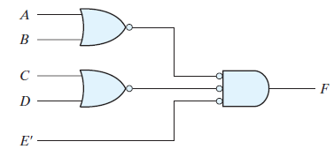
Realization of logic expressions using NOR
As an example consider the Boolean expression
F = (A + B)(C + D)E
The above expression can be realized using basic gates (with some manipulation) as shown below:
Figure: Realization of Boolean expression using NOR

Slide 16
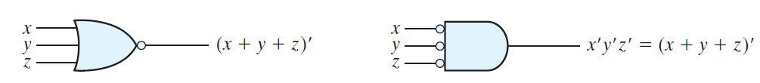
Realization of logic expressions using NOR
The bubbled AND gate in the second stage can be replaced by a NOR gate
Figure: NOR gate representation
Thus a Boolean expression can be realized using NOR gate as discussed above

Slide 17
Realization of logic expressions using AOI
Most Boolean reductions result in a Product-of-Sums (POS)
expression or a Sum-of-Products (SOP) expression
The Sum-of-Products means the variables are ANDed to form a
term and the terms are ORed. X = AB + CD
AND-OR-Inverter gate combinations (AOI) are available in standard
ICs and can be used to implement SOP expressions

Slide 18
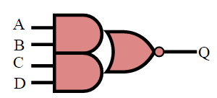
Realization of logic expressions using AOI
The AND-OR-Invert (AOI) gate is a two-level complex logic cell
constructed from one or more AND gates followed by a NOR gate
Two symbols most commonly used to represent an AND-OR
Invert gate is shown below
2x2 AOI gate
symbol
&
+
&
Figure: AOI representation

Slide 19
Realization of logic expressions using AOI
General procedure to convert a logical expression to AOI form:
Compute complement of the function in sum-of-products form
By grouping the 0s in the Karnaugh map
Example: XOR implementation––A xor B = A' B + A B'
AOI form: F = (A' B' + A B)'
A
A'
0 1
1 0
B'
&
A
+
F
B
&
B
Figure: AOI conversion

Slide 20
Summary
A combinational circuit consists of logic gates whose outputs at
any time are determined from only the present combination of
inputs
Any Boolean expression can be implemented using NAND gate or
NOR gate.
The AND-OR-Invert (AOI) gate is a two-level complex logic cell
constructed from one or more AND gates followed by a NOR gate

